Slide 1
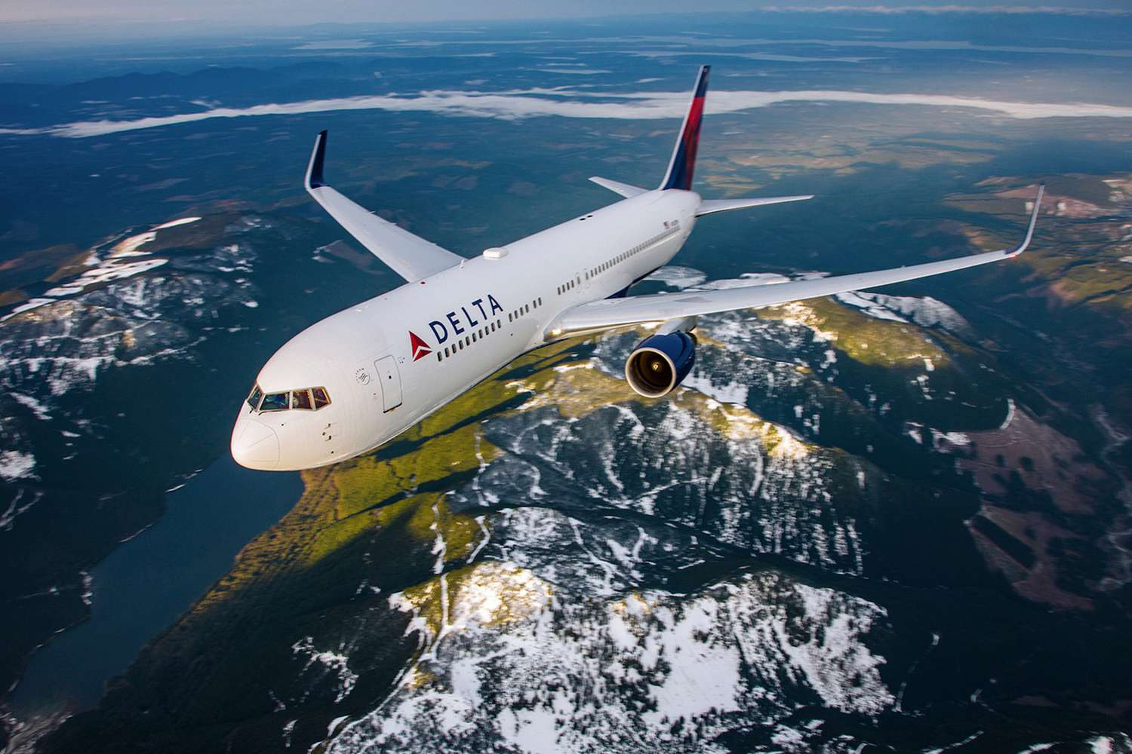
Data Cleansing
By Nungo Tshidzumba

Slide 2
AGENDA
What was used to cleanse the data
Data Assessing
Checking the index to display the correct columns
Reload dataset to include correct headers
Handle Missing Data
Remove outliers and unusual values
Data Transformation

Slide 3



What was used to cleanse the data
Python
Jupyter Notebook
Chat GPT
Claude AI

Slide 4
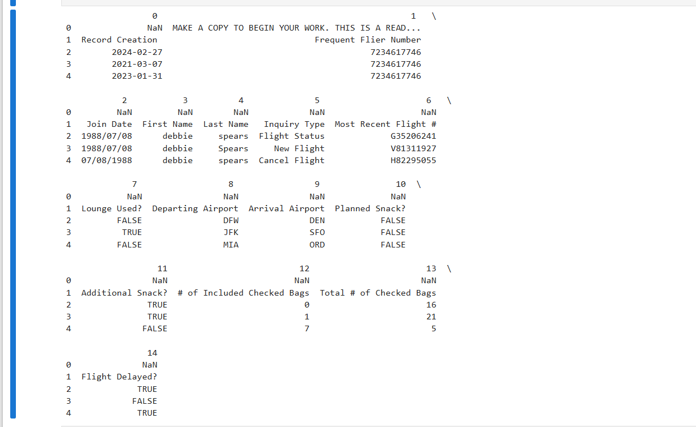
Data Assessing
Upload Delta Airlines Loyalty Customer Raw Data excel file
Cleansing Frequent Flier Raw sheet
Upload and import the dataset
From there read the data so we can assess the first few rows

Slide 5
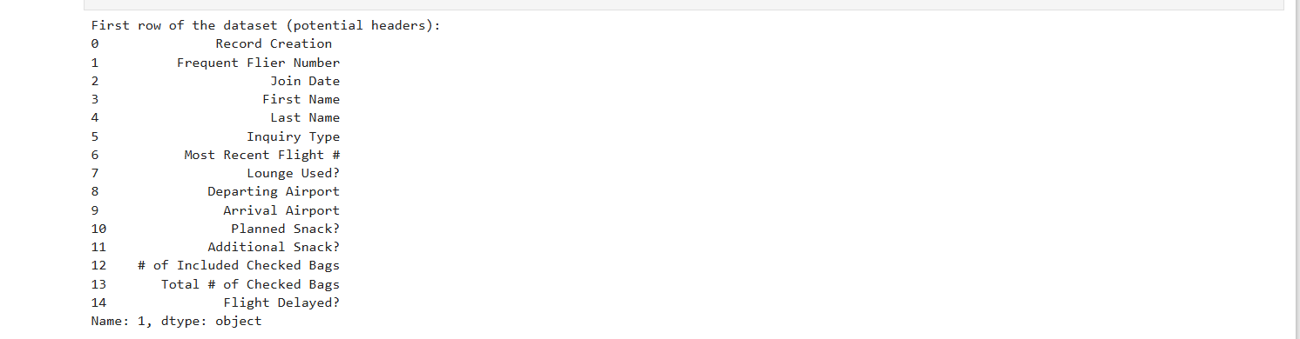
Checking the index to display the correct columns
Since the first index [0] display unnecessary header, we will use the second index[1] which display the correct columns

Slide 6
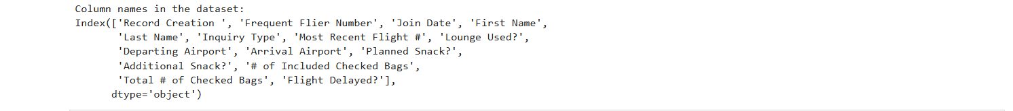
Reload dataset to include correct headers(column names)
Removed unnecessary header, now dataset shows the correct columns we need to cleanse

Slide 7
Handle Missing Data
Identify missing values using isnull() function
Fill missing values with appropriate defaults
Fill missing IDs with “unknown”
Fill missing bag counts with 0
Fill missing lounge usage with false
Check for missing values after filling
Convert data types to proper data types
Verify data types after conversion

Slide 8
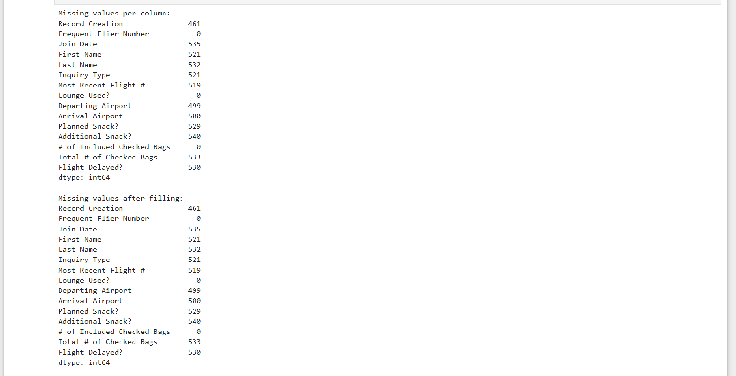

Slide 9
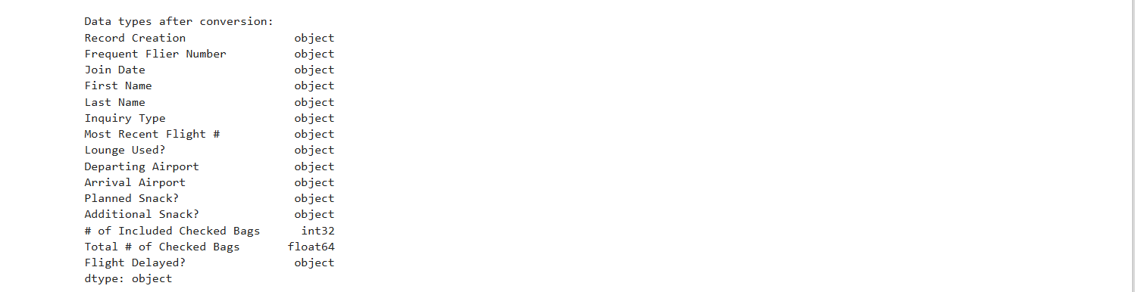

Slide 10
Remove outliers and unusual values
Import numpy library
Check for negative values and set them to Nan
Display data to check for any outliers

Slide 11
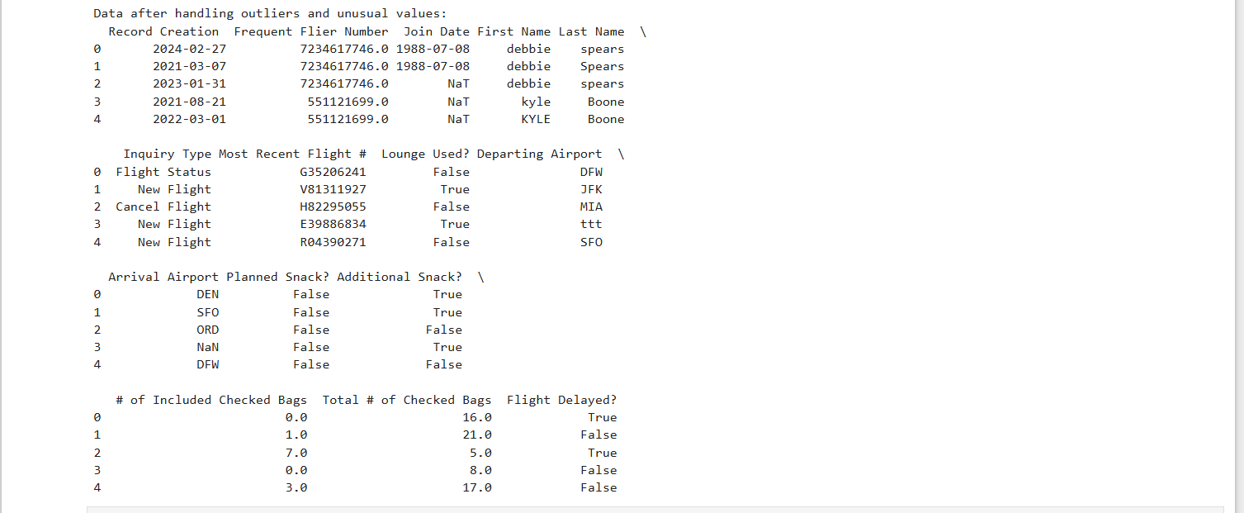

Slide 12
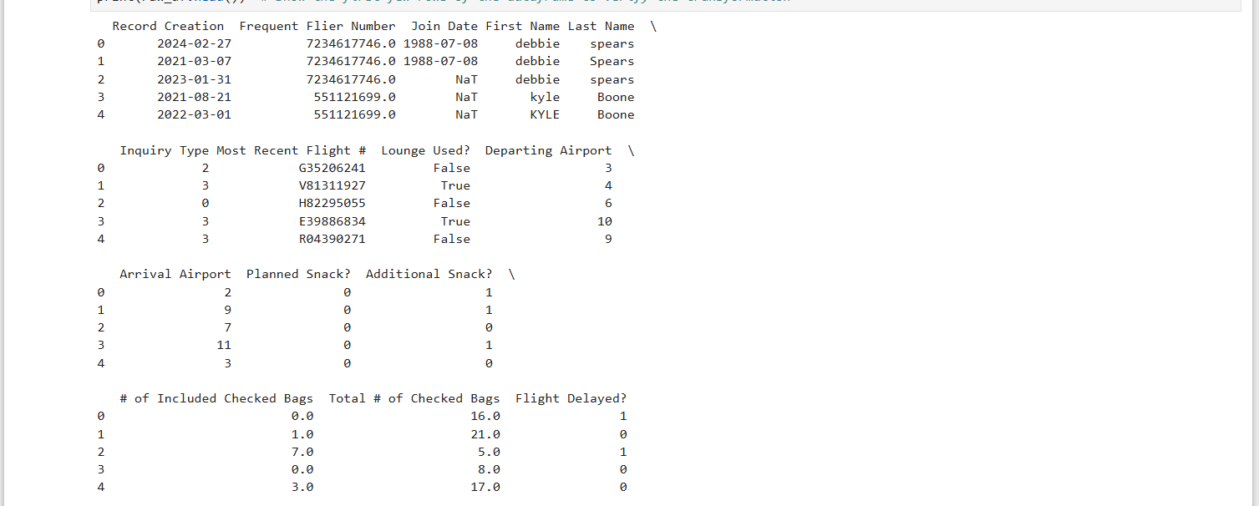
Data Transformation
Display first few rows of cleaned dataset
Export dataset into excel or csv file for later access or use

